Slide 1
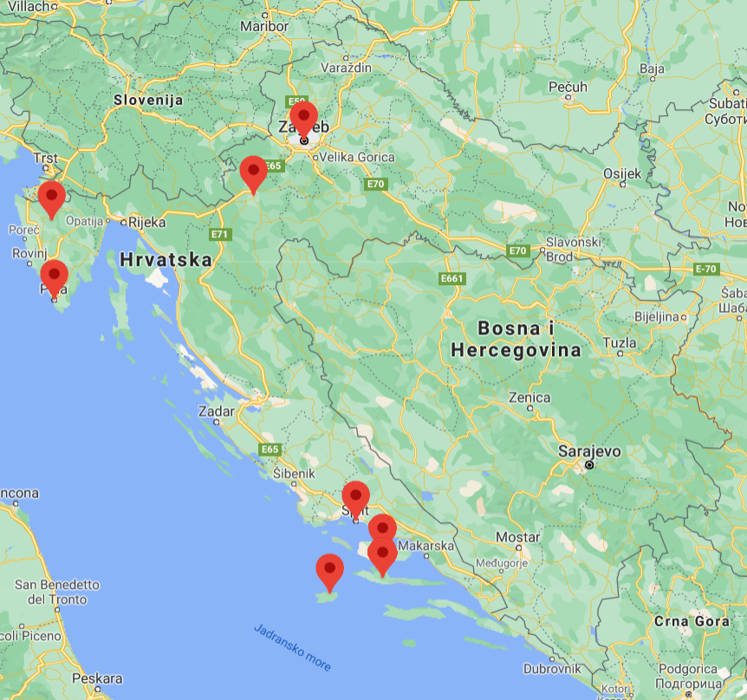
PLACES TO SEE AND EVENTS TO BE IN CROATIA

Slide 2
Recommendations of Croatian high school students for a good time in Croatia
where to have the best time, get to know the culture and enjoy Croatia
focus on the interest of the young, but all generations can find something for themselves ☺

Slide 3
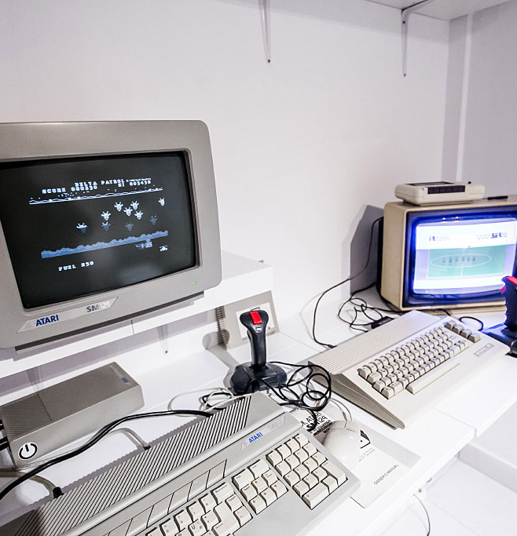
Zagreb 80’s Museum
located in Radićeva street in the centre of Zagreb
includes a collection that has been largely donated by city locals
recreates an entire '80s apartment
shows how the city looked back in the days of Yugoslavia

Slide 4
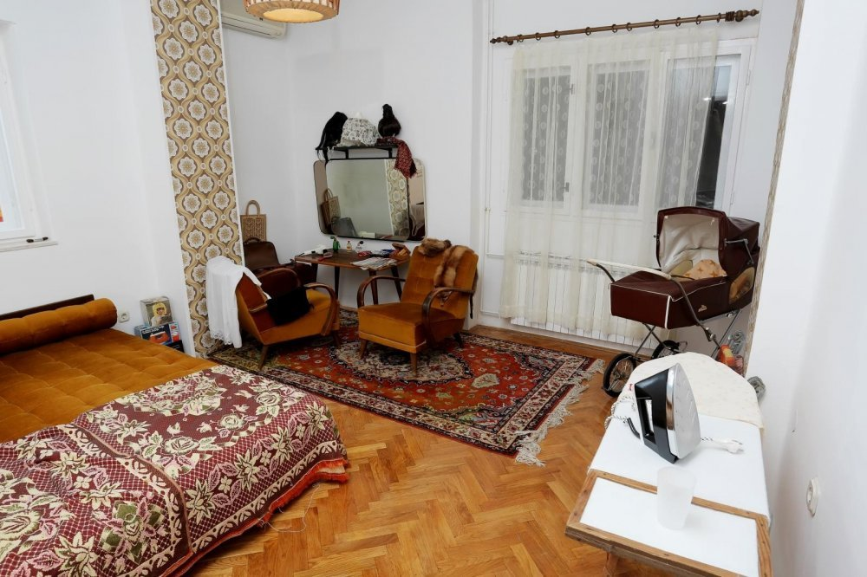
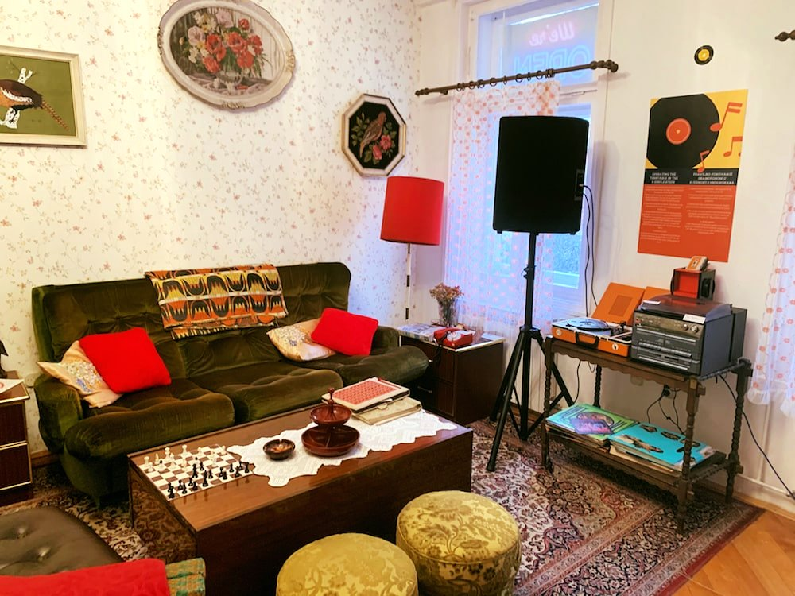
Things to look out for include the Commodore 64, the world's first popular home computer released in 1982, a bulky 18-inch black and white television, old issues of Erotika magazine and many more things

Slide 5
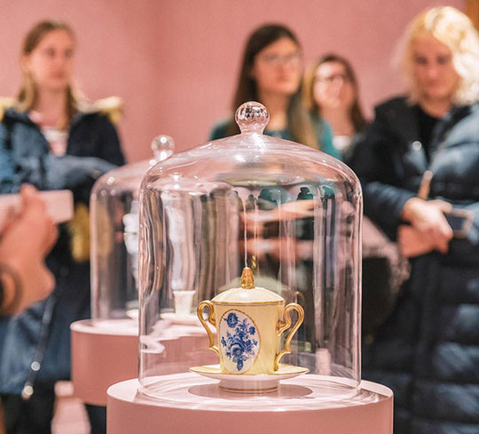
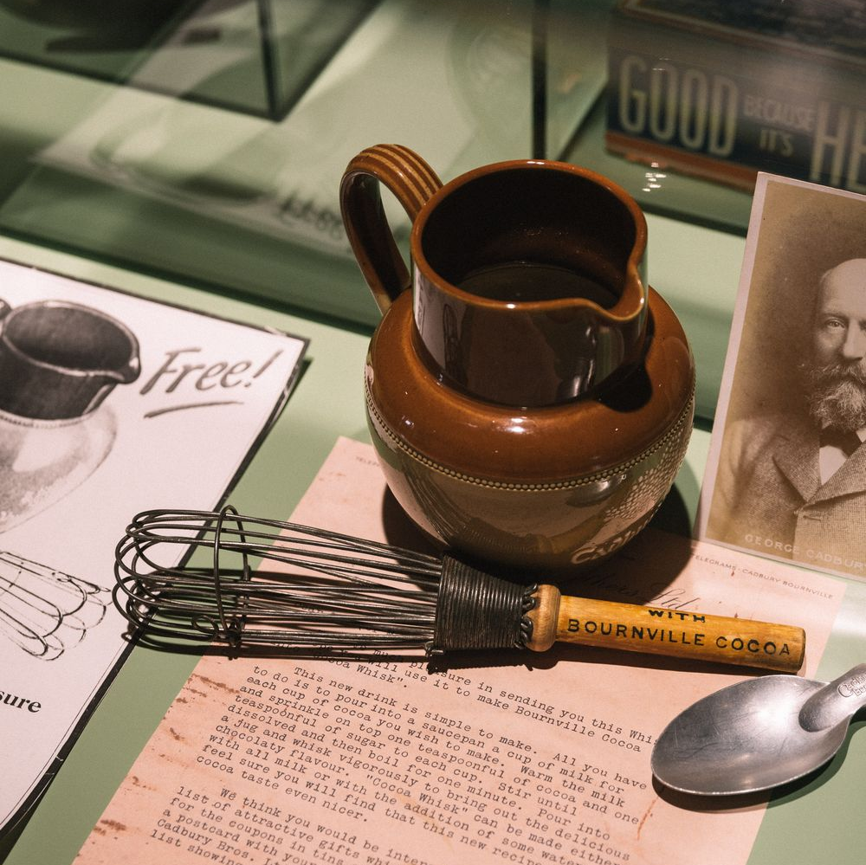
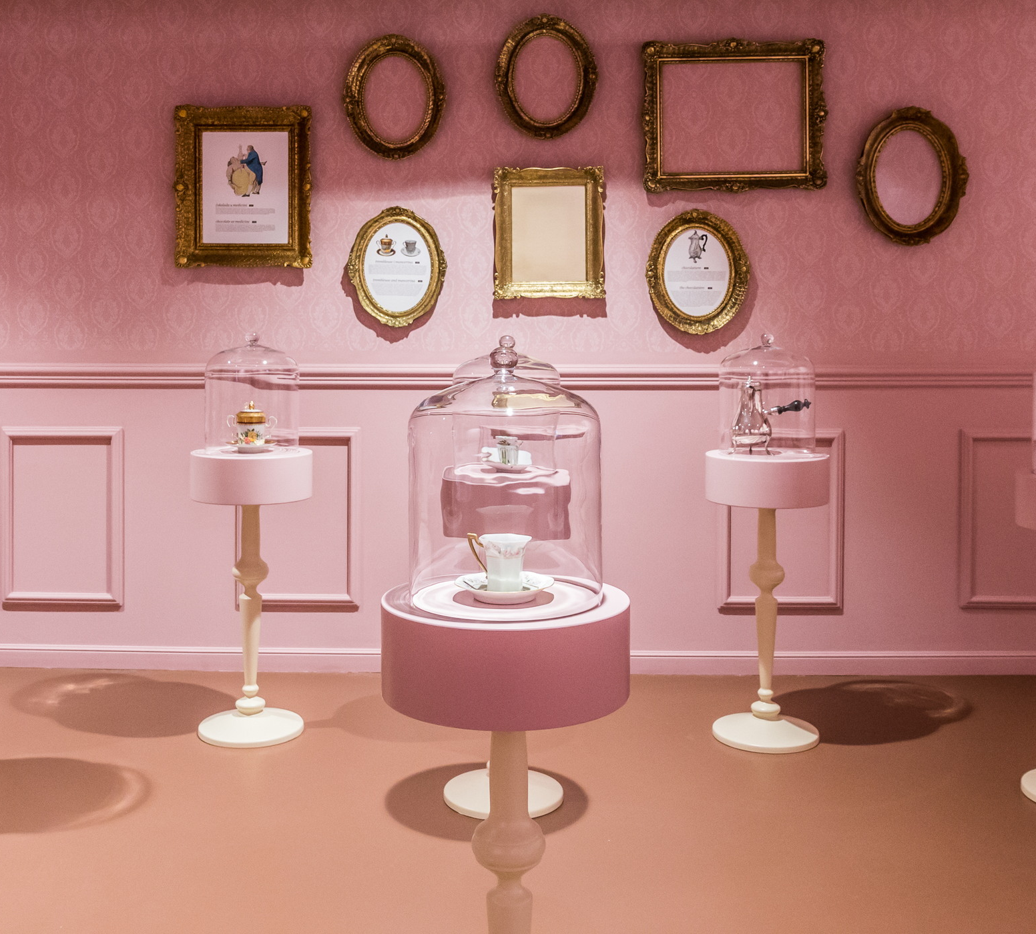
Zagreb Chocolate Museum
located in Varšavska street
dedicated to chocolate and its significance
taste chocolate in various forms and see chocolate-related object from various timelines
see the beginnings of chocolate as we know it today

Slide 6
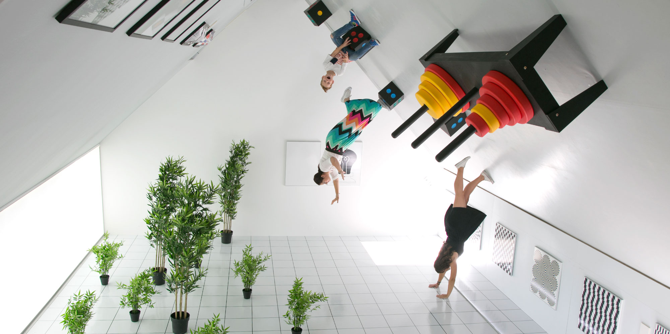
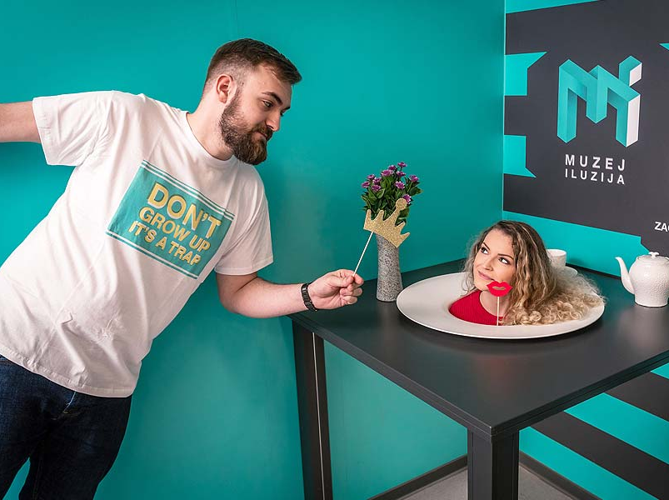
Museum of Illusions
started as an innovative project in Zagreb in 2015.
one of the fastest-growing educational and entertainment spaces
offers an intriguing visual, sensory, and educational experience
over 70 exhibits

Slide 7
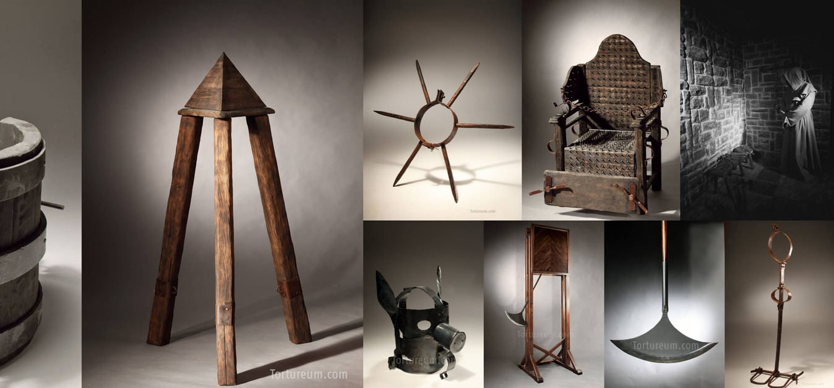
Museum of Torture
unique museum in Zagreb
showcases a picture of violence through history
more than 70 devices
a reminder of human history in which violence arises from fear of the unknown and different

Slide 8
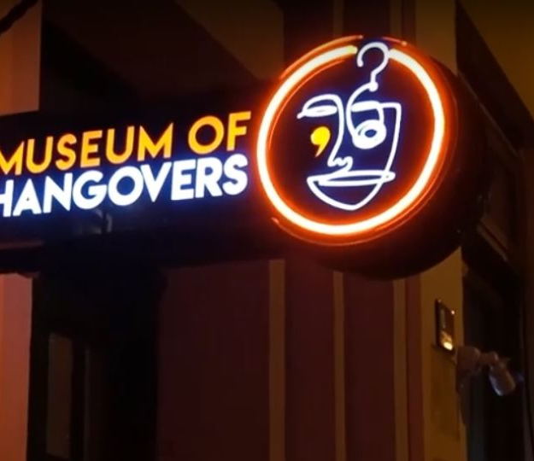
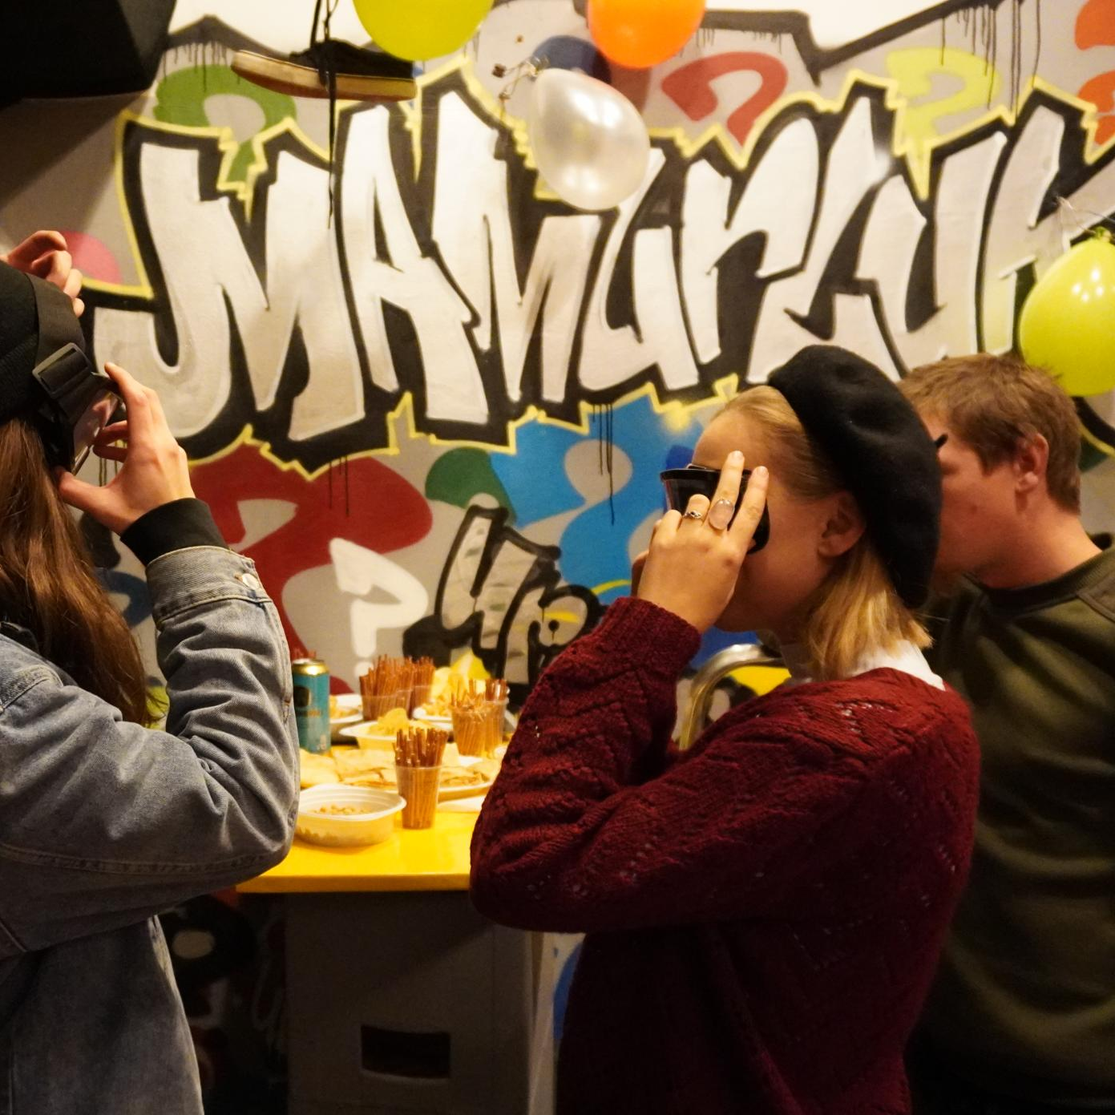
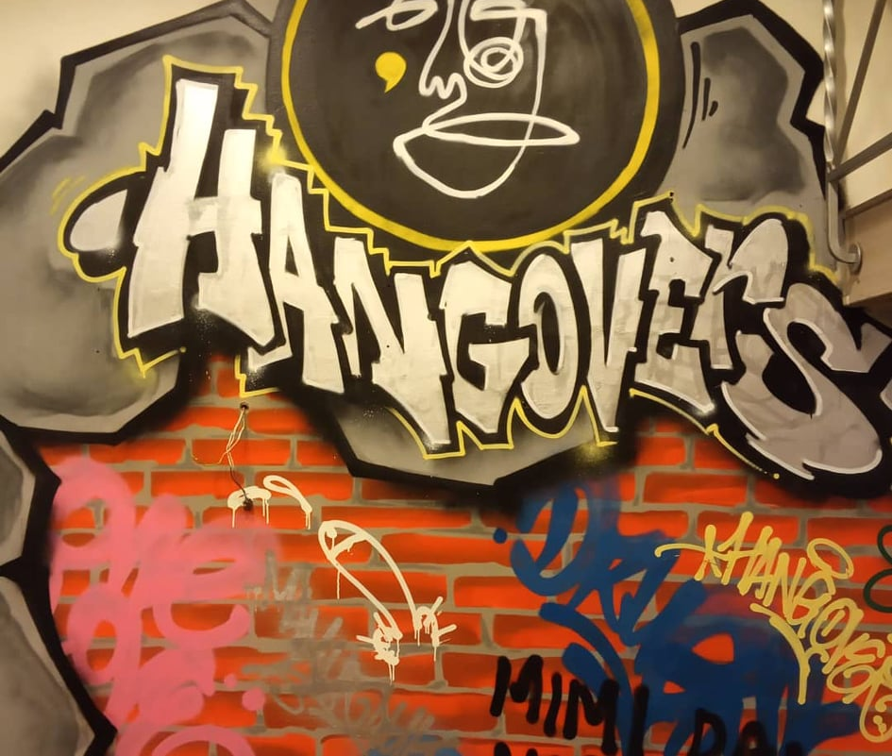
Museum of Hangovers
located in Zagreb
ticket is 30 kunas (4 euros)
drinking games, crazy drunk memories from different people goggles that simulate drunk state of mind
founded by two friends that had a lot of drunk stories

Slide 9
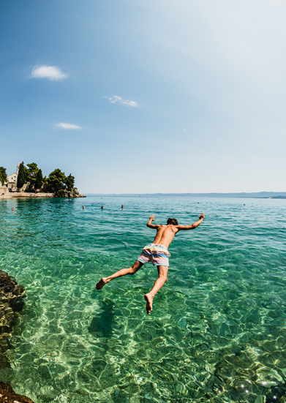
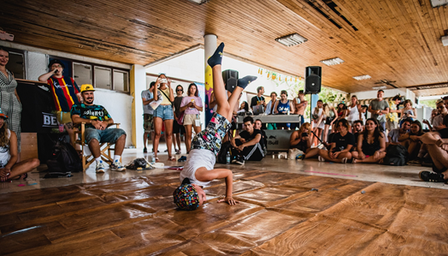
Graffiti na gradele
Graffiti na gradele is original Croatian music festival that is held every year at the end of July in beautiful city of Bol, Brač. It was held nine times so far and it is expected to be held next year also.

Slide 10
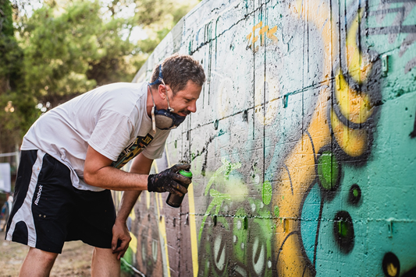
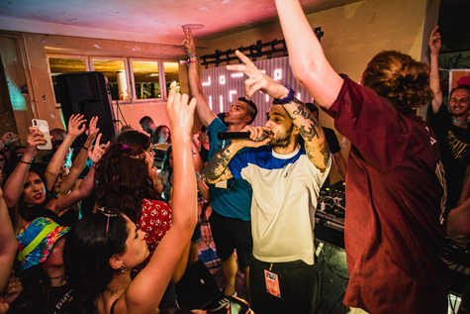
This festival is so specific and different from others because here perform rappers from Croatia. If you want to have great time by the sea side, watch amazing graffiti while listening to Croatian trap this is the place.

Slide 11
Zagreb film festival
In November
promotion of debut films and new authors
Zagreb cult cinema (Europa Cinema, Tuškanac Cinema) and the Museum of Contemporary Art

Slide 12
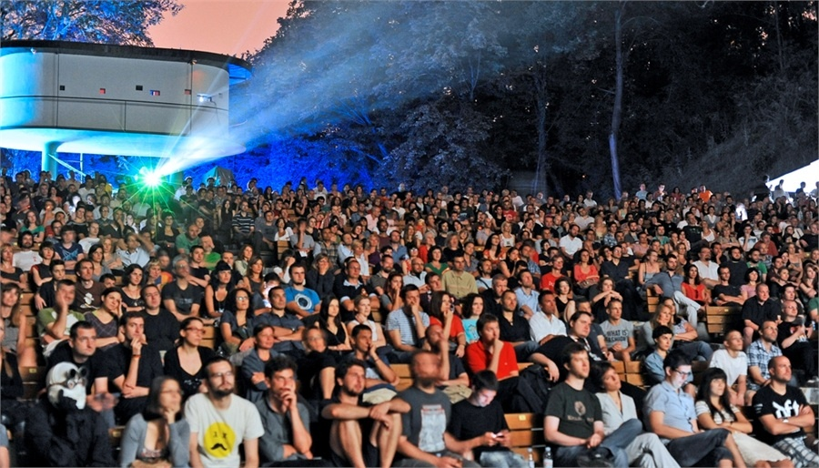
Zagreb cult cinema (Europa Cinema, Tuškanac Cinema) and the Museum of Contemporary Art
diverse film and educational content for audiences of all ages

Slide 13
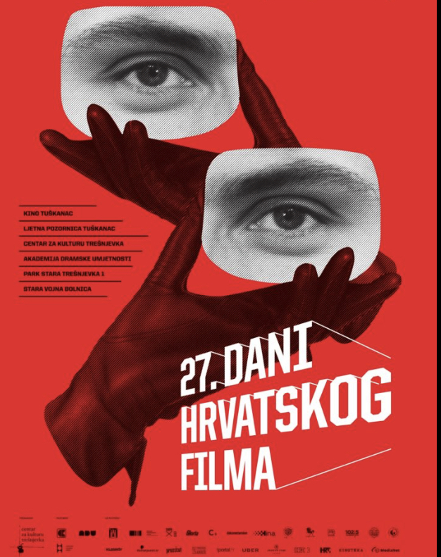
Days of Croatian film
June
national festival held in Zagreb
the festival is dedicated to the annual production of medium-length, short feature, documentary, experimental, animated and special-purpose film

Slide 14
Animafest
June
Zagreb
Is the second oldest film festival entirely dedicated to animation and one of the most important animated film festivals in the world
Open-air screenings, numerous lectures, professional symposium, exhibitions, workshops and educational content

Slide 15
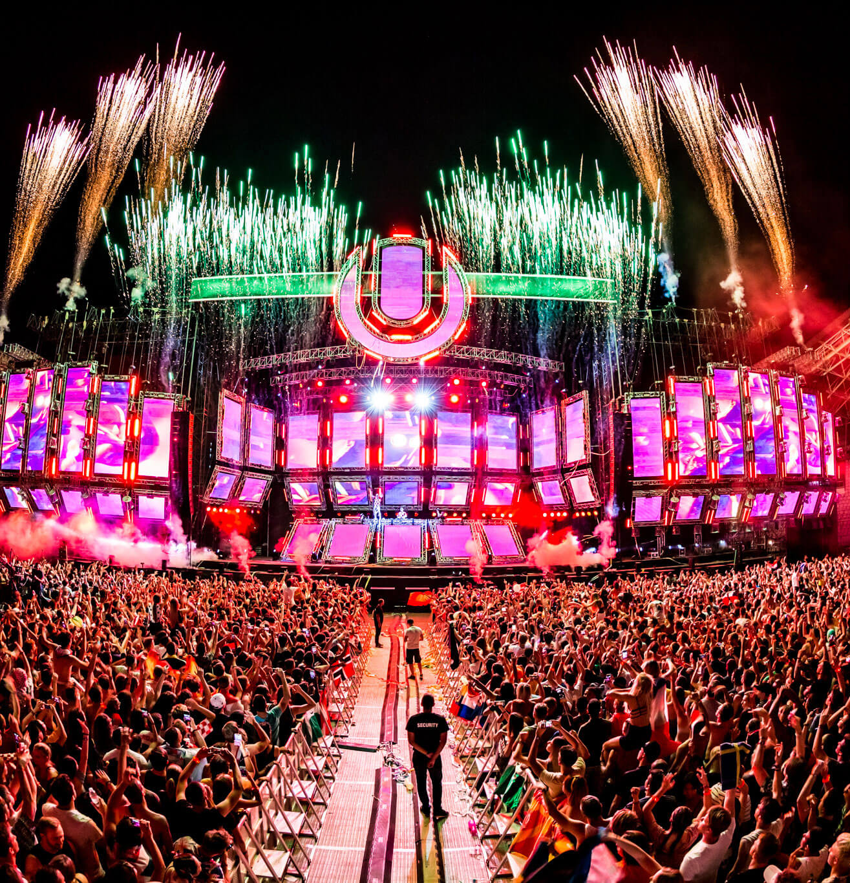
Ultra Europe
one of the biggest festivals of electronic music in the world
in July in the city of Split
after three days there, it continues on the island of Brač, Hvar and Vis
famous DJs that performed there: Martin Garix, Armin van Buuren, Markus and Robin Schulz, David Guetta, Hardwell, etc.

Slide 16
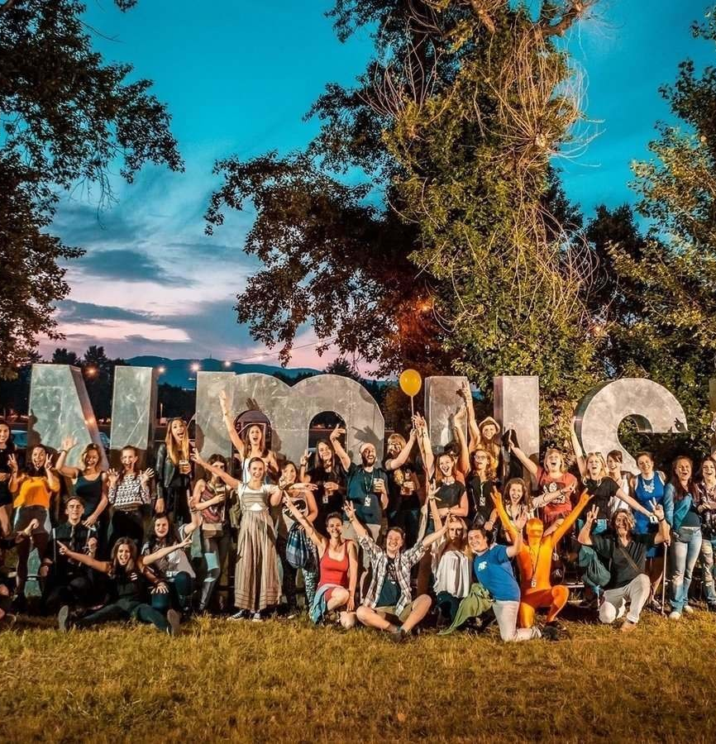
Zagreb Inmusic Festival
one of the best music festivals in the world!
every year in June, on Jarun lake in Zagreb

Slide 17
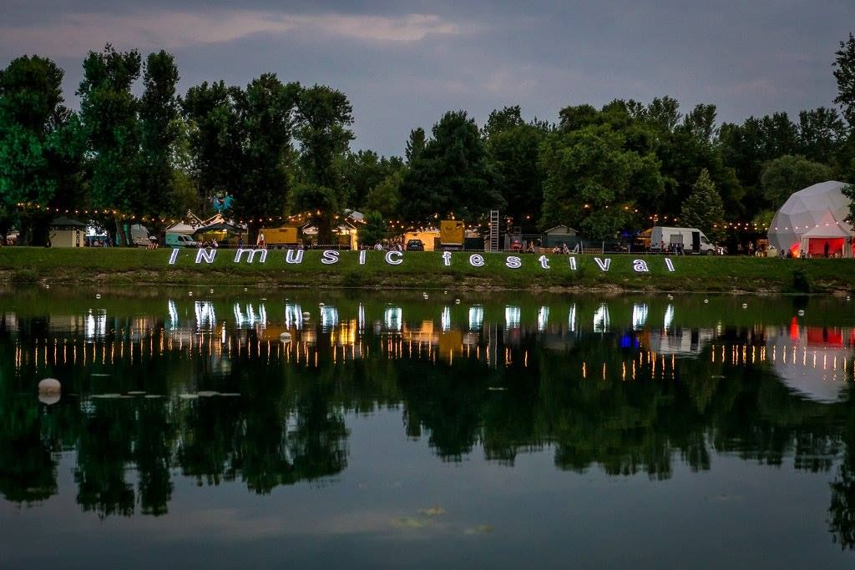
hosts world superstars like Arctic Monkeys, Jamiroquai, The Prodigy, New Order, Nick Cave and the Bad Seeds, The Black Keys, Pixies, MGMT, Foals, Iggy and the Stooges…

Slide 18
Motovun film festival
in July/August, in Motovun
is dedicated to films made in small cinemas and independent productions
feature, short feature and documentary films

Slide 19
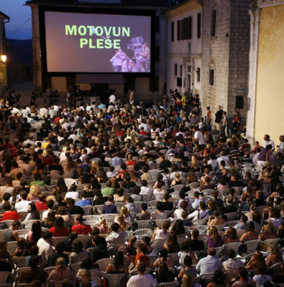

Slide 20
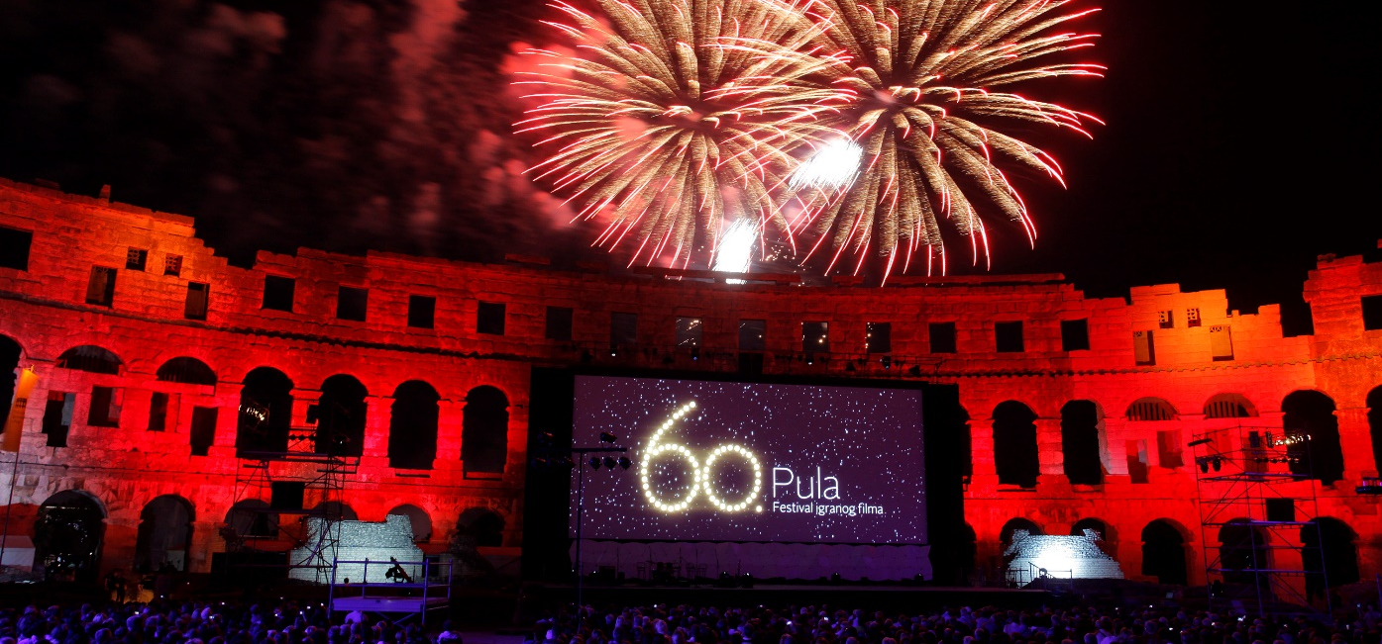
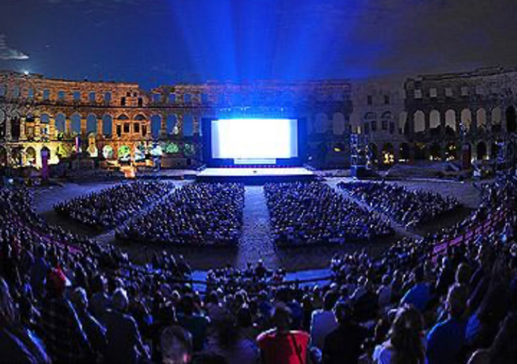
Pula film festival
in July, in Pula
second oldest continuous film festival in Europe and the world (since 1954)
feature films

Slide 21
THANK YOU FOR YOUR ATTENTION AND WE HOPE WE WILL SEE EACH OTHER IN CROATIA! ☺
Druga gimnazija, 3rd grades, 2020/2021

